Slide 1

HTML, CSS, JS (WEEK-1)
JALAJ JHA

Slide 2
WEEK 1 INSIGHTS

Slide 3
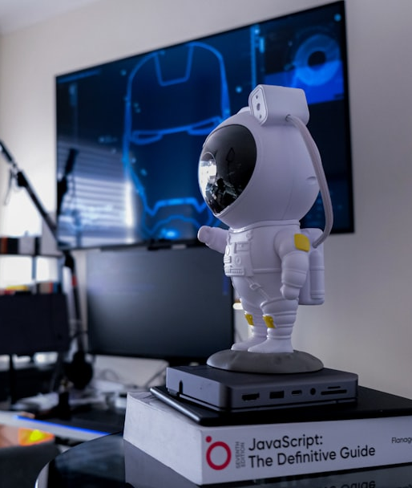
KEY LEARNINGS
HTML (HYPER TEXT MARKUP LANGUAGE):
Semantic Elements
Multimedia Integration
Structure of Web Pages
CSS (CASCADING STYLE SHEETS):
Styling and Layout
Responsive Design
Selectors
JS (JAVASCRIPT):
Event Handling
Dynamic Behavior
DOM Manipulation
Integration: HTML, CSS, and JavaScript work together to create structured, styled, and interactive web applications.

Slide 4


CHALLENGES ENCOUNTERED
Form Handling:
Properly handling form submission and resetting the form.
Dynamic Video Display:
Switching between videos based on user selection.
Animation Effects:
Implementing smooth animations for elements when loading.
Image Visibility Control:
Struggled to hide bulbs upon clicking.
.

Slide 5
SOLUTIONS IMPLEMENTED
CHALLENGE | SOLUTION | OUTCOME
Form Handling | Implemented handleSubmit() function to manage form submission. | Achieved form handling features.
Dynamic Video Display | Developed changeVideo() function that toggles the active class on video iframes. | Successfully displayed one video at a time.
Animation Effects | Created keyframe animations in CSS and applied them to elements to enhance user experience. | Created a more visually appealing layout.
Image Visibility Control | Used style.display to hide images and correctly referenced elements. | Resolved image display issues.

Slide 6

REFLECTION
&
GROWTH
Understanding User Experience
Problem-Solving Mindset
Importance of Testing
CSS Styling and Animation
Collaboration and Feedback
Enhanced Technical Skills
GIT

